Slide 1
UNIT-3
WIDGET
Prof. Nilesh Parghi
KSC - AMRELI

Slide 2
What is widget & widget Areas?
What is Widget????
Widgets are small blocks that perform specific functions.
You can add these widgets in sidebars also known as widget-ready areas on your web page.
Widgets give design and structure control to the WordPress theme.
Some specific features of a widget are:
They help you add content and features
They can be easily dragged and dropped in widget area
They vary from theme to theme. They are not same for every theme

Slide 3
There are many different types of widgets.
WordPress by default comes with several widgets including categories, tag cloud, navigation menu, calendar, search, recent posts etc.
If you drag the recent posts widget in a widget area, then it will contain a list of recent posts.

Slide 4
What is widget area????
Widgets in WordPress allow you to add content and features in the widgetized areas of your theme which is mostly the sidebar.
These widget-ready areas can be in the header, footer, sidebar, below content, and basically any other area in your theme.
The available widget areas that you have in your theme will vary from theme to theme.
Most WordPress themes are widget ready and have multiple widget areas.
If you do not see any widget areas, then it means that your theme does not support widgets.

Slide 5
Widget Management
Available Widgets
Archive
The Archives Widget organizes your previously published posts by month.
This can be handy for readers who want to browse your older content.
Configuration :
Title — Customize the title that displays above the widget in your sidebar. (For example, Archives, Old News.)
Show post counts — If this box is checked, the total number of posts published during that month will be displayed next to the link.

Slide 6
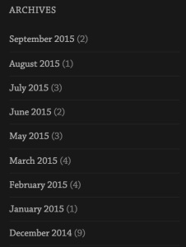
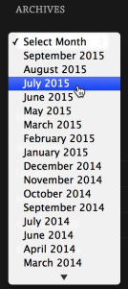
Display as a drop down — Check this box to display the months on a single line, as a drop down menu, rather than as a list. This is handy if you want to save space or have been writing your blog for a long time.

Slide 7
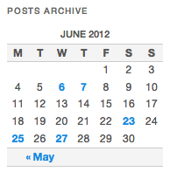
2) Calendar
The Calendar Widget is a simple, easy-to-use widget that displays links to your posts by date.
It does not let you create a calendar of events or anything similar.
Settings
Title: Set the title to be displayed above the calendar in your sidebar. (i.e. Calendar, Posts This Month)

Slide 8
3) Categories
The Categories Widget organizes your posts by category in your blog’s sidebar.
This can be handy for readers who want to find more of your posts about certain topics.
Configuration :
Title — Customize the title that displays above the categories in the sidebar. (For example, Categories, Subjects, Areas of Expertise.)

Slide 9
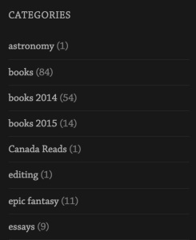
Show post counts — If this box is checked, the total number of published posts for that particular category will be displayed next to the link. You can show post counts with both the list and dropdown menu formats.

Slide 10
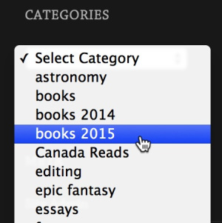
Show as dropdown — Check this box to display the categories in a drop down menu rather than as a list. This is handy if you want to save space or have a lot of categories.

Slide 11
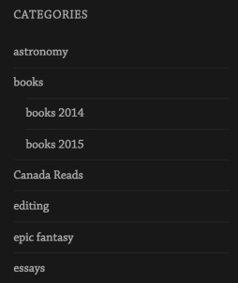
Show hierarchy — If you have parent and child categories (subcategories within main categories) you can choose to display the hierarchy (pictured below) or just leave the list “flat,” without indicating which subcategories fit inside your main categories (pictured above). You can show category hierarchies with both the list and dropdown menu formats.

Slide 12
4) Pages
The Pages widget displays your blog’s pages in your sidebar.
This can make it easier for your readers to navigate around your blog.
Settings :
Title: Set the title to be displayed above the list of pages.
Sort by: When displaying the list of pages you can sort by Page title, Page order, or Page ID. Selecting Page title will display your pages alphabetically. With Page order, you take control over the ordering. You will need to set the page order option for each page. Sorting by Page IDs will display your pages in the order they were first created.

Slide 13
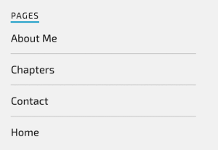
Exclude: If you would like to exclude any pages from being displayed, you can enter the Page IDs (separated by commas). To find the Page ID, go to My Site → Pages and click the title of the page. The address bar of your browser will display a URL with a numeric ID at the end. This is the page ID.

Slide 14
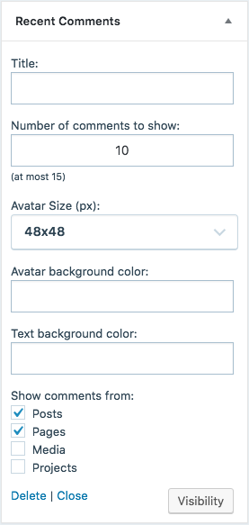
5) Recent Comments
The Recent Comments widget is a sidebar tool that displays the most recent comments readers have left on your blog.
Settings :

Slide 15
Title : Set the title that will display above the recent comments area in your sidebar. (i.e. Recent Comments, What Readers Are Saying, etc.)
Number of comments to show : How many of the recent comments you would like the widget to display. The maximum you can show is 15.
Avatar size (px) : Set the display size of the avatars or choose not to show avatars at all. (Avatars must be set to display in the Discussion Settings for this to work.)
Avatar background color (Optional) : Background color to use for the avatars. This value should be either a hexadecimal color, like #000 for black or #fff for white or the name of a color, like yellow or blue.
Text background color (Optional) : Background color to use for the text. This value should be either a hexadecimal color, like #000 for black or #fff for white or the name of a color, like yellow or blue.
Show comments from : Select which types of posts to show comments from—you may select one or more.

Slide 16
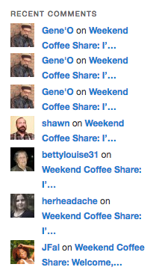

Slide 17
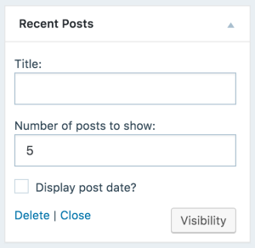
6) Recent Posts
The Recent Posts Widget displays your most recent posts in your sidebar.
Recent Posts making it easy for your readers to see what’s new on your blog.

Slide 18
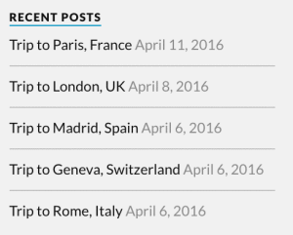
Setting :
Title: Sets the title that will display above the recent posts in the sidebar. (e.g., Latest Posts, What’s New)
Number of Posts: Limits the number of posts to display. (If you have fewer posts than the limit, that number of posts will show.)
Display post date: Shows or hides the published date of the post.

Slide 19
7) Search
The Search widget adds a search box to your blog sidebar or footer, allowing readers to easily search your site for posts and pages you’ve written in the past.
Settings
Once you add the widget to your sidebar from Customizer → Widgets, you’ll see that you can customize the title (i.e. Can’t Find What You’re Looking For?):
What It Searches???
The Search widget will return results from the titles and the bodies of your posts and pages, and from media titles, alt text, file names, and single image captions.

Slide 20
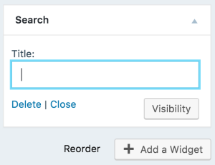
It will not return results from widgets, comments, categories, gallery captions or other text, or tags.
Also, note that the search results will display posts with the matching term in the post title in reverse-chronological order.

Slide 21
8) Text
The Text Widget allows you to add text and HTML to your sidebar.
It’s the most popular widget because of its power and flexibility — use one to display text, links, images, or any combination.
Text Widgets fall under the same code security restrictions that posts and pages do, so if you use any code that isn’t allowed, it won’t be displayed.
The font and appearance of text widgets varies by theme, so yours text widget look will different.
Delete Widget : If you would like to remove a widget from the sidebar, open the widget’s settings and click the Delete link.

Slide 22
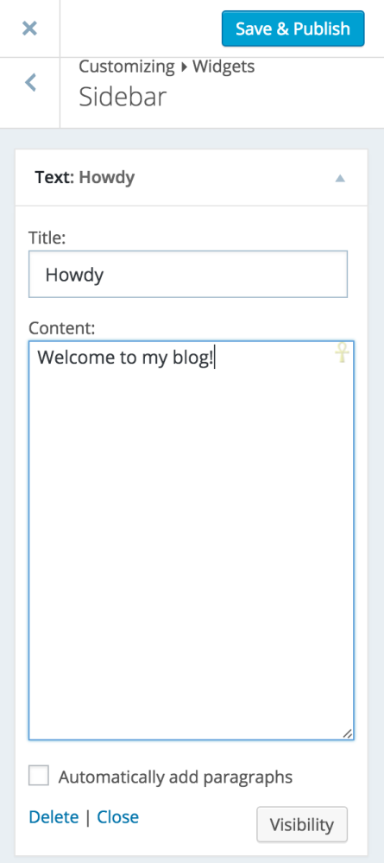

When you’re satisfied, click Save and publish to add the widget to your live site.

Slide 23
9) Tag Cloud
The Tag Cloud widget shows a list of all the tags you’ve assigned to your posts.
The most common tags will be displayed in the largest font size.
This widget is helpful because it gives your readers an at-a-glance view of your favorite subjects, and lets them know what topics you write about most frequently.
The Tag Cloud widget will display up to 75 of your most popular tags.

Slide 24
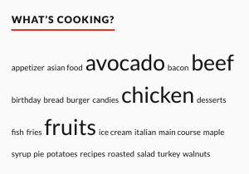

Slide 25
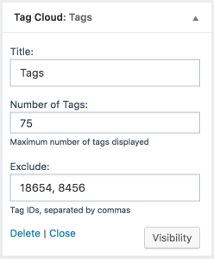
Widget Settings
Title: The title displayed above the widget on your blog.
Number of Tags: The maximum number of tags displayed in the tag cloud (up to 75).
Exclude: The tag IDs for tags you don’t want to display in the tag cloud.

Slide 26
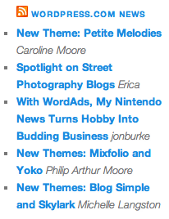
10) RSS
The RSS Widget displays posts from any RSS feed.
You might find this handy if you want to show off one of your other blogs, or one of your favorite blogs, in your sidebar.

Slide 27
Settings
Enter the RSS feed URL here: You will need to get the RSS feed URL from the blog or web site you would like to display in the sidebar.
Some RSS feed examples:
http://en.blog.wordpress.com/feed/ – WordPress.com news feed
http://www.nytimes.com/services/xml/rss/nyt/Opinion.xml – New York Times Op-Ed headlines

Slide 28
Give the feed a title: Set the title displayed above the feed items.
How many items would you like to display?: Sets the number of entries from the feed to show on your sidebar.
Display item content?: Check this box to show a brief excerpt from the post in addition to its title.
Display item author if available?: Check this box to show the author’s name.
Display item date?: Check this box to show the date the post was published.

Slide 29
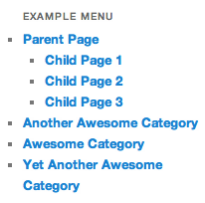
11) Custom Menu
The Custom Menu Widget allows you to display pages, categories, and custom links in your blog’s sidebar.
To use it, you first need to create a custom menu.
Here’s an example of what it looks like when it’s activated on a blog sidebar.

Slide 30
Widget settings :
Title: Sets text that will display immediately above the custom menu in the sidebar.
Select Menu: Use this to choose which of your custom menus to display. If you haven’t already created a custom menu, you’ll need to do that first on the Menus page.

Slide 31
12) Meta
The Meta widget gives you links to login to your blog (logout if you are logged in), your admin, your comments and posts feeds and a link to wordpress.com.
Meta Widget is one of standard WordPress widgets. By default it contains 5-links menu.
Register/Site Admin link redirects to your WordPress dashboard or registration form (it depends if you are logged in to your account or not).
Log in/out link is used for calling for the login form on your site login page or logging out from site admin panel.
Entries RSS link opens your site feeds (most recent first).
Comments RSS link opens your site comments feeds (most recent first).
WordPress.org link opens official WordPress community site

Slide 32
Widget settings :
Title: Sets text that will display immediately above the meta widget link in the sidebar.

Slide 33
13) Image
The image widget allow the developers to display image in sidebar of your wordpress website.
Image widget will bring up the WordPress media uploader where you can click on the upload files button to upload your image or select an image you have previously uploaded.
After uploading the image, you will see image settings in the right column. From here, you can provide a alt text for the image, add a description, select size, or even add a link.
Once you are done, you can click on the ‘Add to Widget’ button to save your changes.

Slide 34
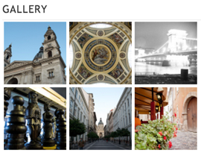
14) Gallery
The Gallery widget provides you with a simple way to display a photo gallery or slideshow in your blog’s sidebar.

Slide 35
Settings
1) Title: The title to be displayed above the gallery in your sidebar.
2) Images: The images to be displayed in the gallery. You can click on Choose Images to select the images for your gallery.
After performing setting for every image in gallery click on save button to save your gallery.

Slide 36
15) Video
The Video Widget allows you to add a video to the sidebar or footer of your site. You can add a video that you’ve uploaded to your site.
Click on the Add Video button to select the video you want to put in the video widget.
After you’ve uploaded, click the Add to Widget button to put the video in the Widget.
After you’ve added the video to your video widget, you’ll see a preview of the widget appear on your blog. You can also enter a Title in the widget options, which will appear above the video.
When you’re satisfied, click Save to add the widget to your site.

Slide 37
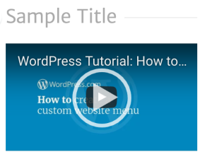

Slide 38
16) Audio
The Audio Widget and Music Player Widgets allows you to add an audio player to the sidebar or footer of your site. You can add an audio player using any audio file that you’ve uploaded to your site.
The font and appearance of the title in widgets varies by theme, so yours will look different.
Audio files must be .mp3, .m4a, .ogg, or .wav type.
After you’ve uploaded your audio, click the Add to Widget button to put the audio in the Widget.
After you’ve added the audio to your audio widget, you’ll see a preview of the widget appear on your blog. You can also enter a Title in the widget options, which will appear above the audio.
When you’re satisfied, click Publish to add the widget to your site.

Slide 39
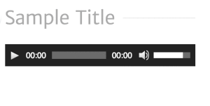

Slide 40
17) Custom HTML
The Custom HTML Widget allows you to add HTML code to the sidebar or footer of your site.
Some HTML tags like script, iframe, form, input, and style are not available on Premium, Personal, or free plans. You need to upgrade to the WordPress.com Business plan and install a custom plugin or theme to use them.
The font and appearance of the title in widgets varies by theme, so yours will look different.
When you’re satisfied, click Save to add the widget to your site.

Slide 41
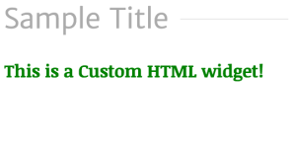

Slide 42
Inactive Sidebar (not used)

